Slide 1
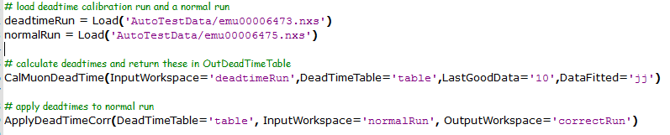
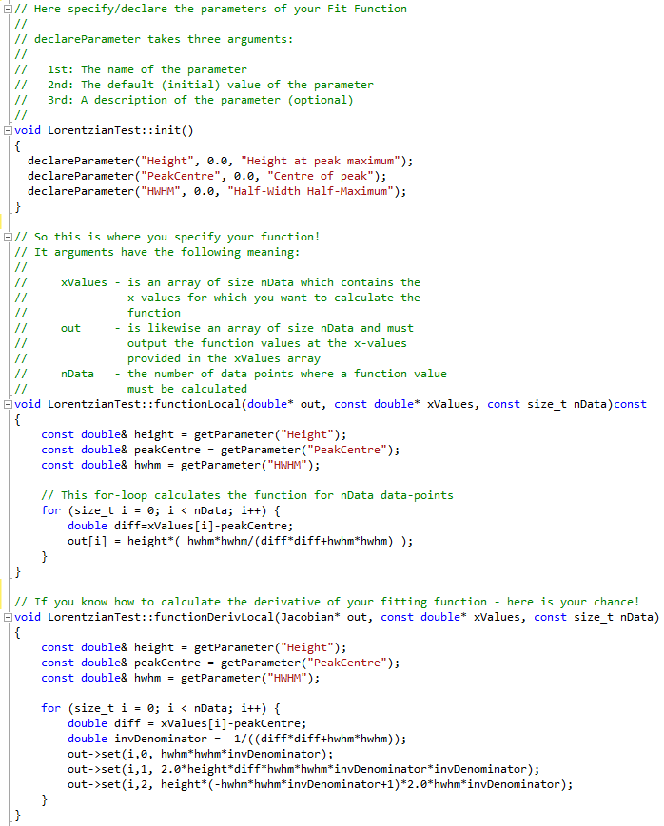
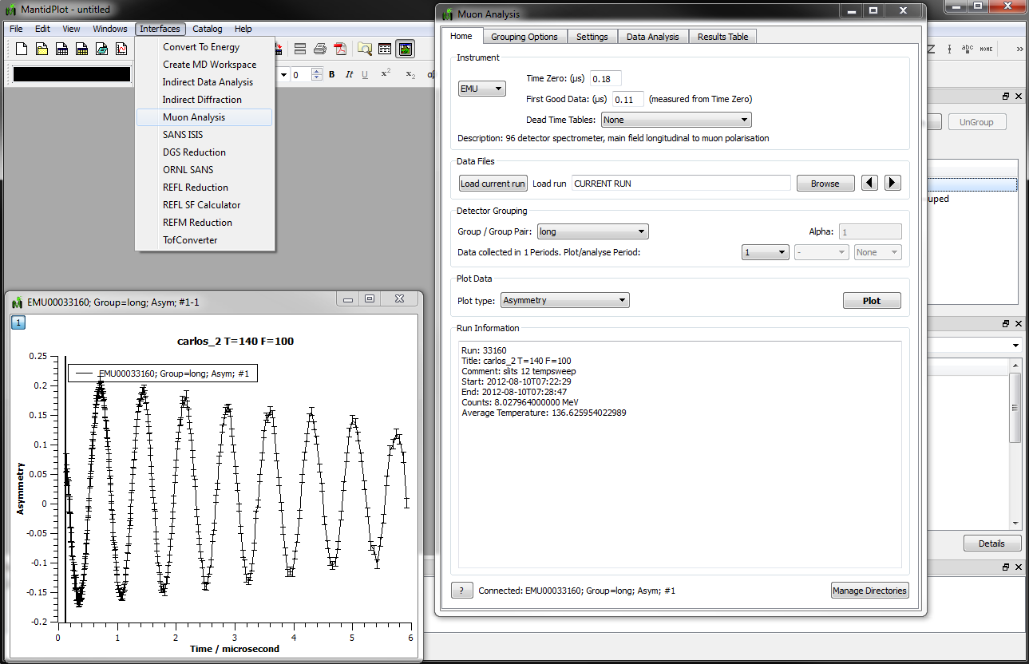
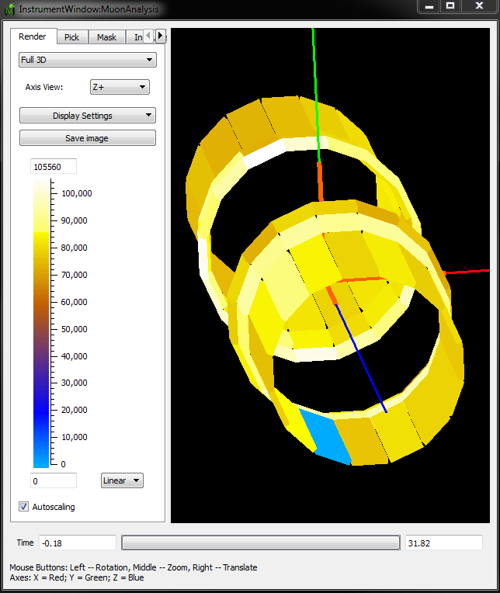
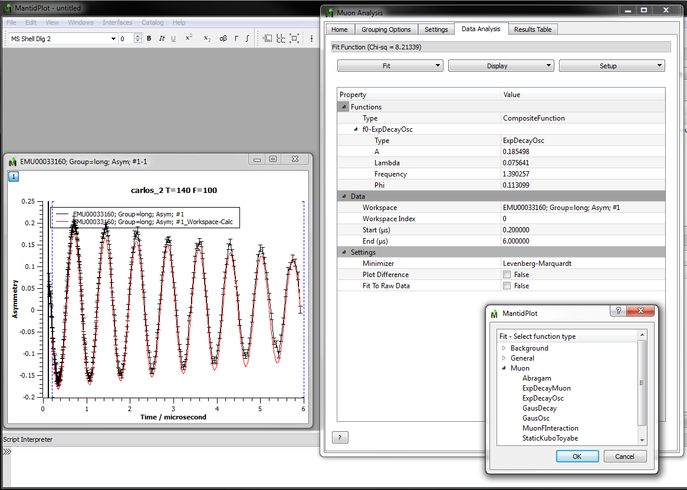
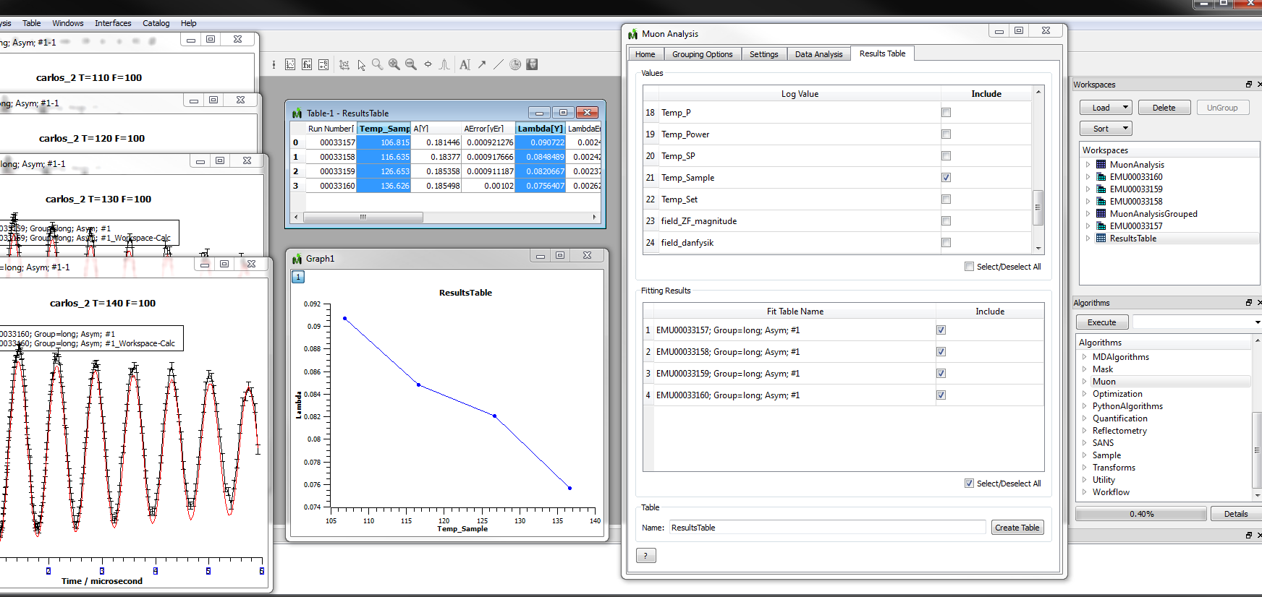



Mantid as a tool for μSR analysis
Anders Markvardsen¹, Robert Whitley¹, Stephen Cottrell¹, Francis Pratt¹, Adrian Hillier¹, Philip King¹, Freddie Akeroyd¹, Nick Draper², Yuan Yao³
¹STFC – Rutherford Appleton Laboratory, Chilton, Didcot, Oxfordshire,OX11 0QX, UK ²Tessella plc, 26 The Quadrant, Abingdon, Oxfordshire, OX14 3YS, UK ³Department of Physics, Clarendon Laboratory, Parks Road, Oxford, Oxfordshire, OX1 3PU, UK
Introduction The development of Mantid (www.mantidproject.org) [see, for example also, the posters entitled “Continuous Build, Test and Deployment – the Mantid Model” and “Deep Integration With Python - The New Mantid API”] offers the muon community access to an analysis framework that is attracting broad international support, with both ISIS and the SNS committed to using it as the primary means of data analysis. The Mantid project provides an open source cross-platform framework of core routines and visualisation tools on which the various scientific communities can build analysis software specific to their needs. Here, we report on a successful development of μSR analysis tools for the ISIS muon group, to analysis data collected on the instruments EMU, ARGUS, MuSR and HIFI. In action | Scripting The visual interface makes calls to Mantid algorithms that are designed and coded to perform specific tasks within the workflow associated with analysing muon data. These include applying deadtime correction to the data, calculating asymmetry plots and data fitting with muon specific functions. All algorithms are available from the Mantid Python scripting interface, enabling users to carry out automated data reduction and to build customised analysis tools for specialised experiments. Below is shown an example where two datasets are loaded and one of these are corrected for deadtimes. | Adding fitting functions Mantid ships with a library of functions to fit against data. In addition Mantid's plugin architecture has been engineered so that it is easy for a user to write their own fitting functions. The latter was used in the early stages of this project, where a student, not otherwise familiar with the Mantid code, was able to create the first set the Muon fitting functions. This library of functions was further tested by members of the muon group, and then added to the Mantid project together with unit tests. To create a custom fitting function requires: MantidPlot installed, a C++ compiler, filling in the blanks of a template .cpp file and a .h file, and placing these in a subfolder of the Mantid install directory. Below is shown a copy of a Lorentzian fitting unction Documentation For documentation on the Mantid Muon interface see www.mantidproject.org/MuonAnalysis. For Mantid doc in general see www.mantidproject.org. Some of the work presented here was also recently reported in S. Cottrell et al., Physics Procedia 30, 20-25 (2012).
Launch MuonAnalysis interface and visualise data
Optionally visualise data on instrument
Launch interface
Fitting data
Analyse results from multiple fits
Function
used for
fit
Workspaces
created
during
analysis
Plot fit parameter, Lambda,
as a function of log value,
Temp_Sample
Available
fitting
functions
Algorithms
library
Acknowledgements: Martyn Giggs, Roman Tolchenov and Karl Palmen

